Slide 1
Web Front End Testing
By Grant W. Walker

Slide 2
Disclaimer
https://www.slideshare.net/JoshJustice1/testdriven-development-in-react
Notes:
I will be referencing a presentation from Josh Justice called Test-Drive Development in React with Cypress. https://www.slideshare.net/JoshJustice1/testdriven-development-in-react

Slide 3
Test Project
Simple project that is like the creation of a blog post.
“Specs”:
Want to be able to create a blog post with a title, topic, and message
The post will show up in a list on the page after we “post” it

Slide 4
Starting Off
Using Angular 7 for the test project
Test framework called Cypress
I will only be building the Feature tests in Cypress
The “Unit Test”/ Component Tests will be in Angular 7 test framework.
Notes:
We are going to assume we have created an Angular 7 project (https://angular.io/guide/quickstart) and have gone through the process of setting yp

Slide 5
Cypress
Similar to Selenium but with more fun features.
https://www.cypress.io/
Key Features:
Time Travel
Real time reloads
Automatic waiting
Debuggability

Slide 6
DEMO!

Slide 7
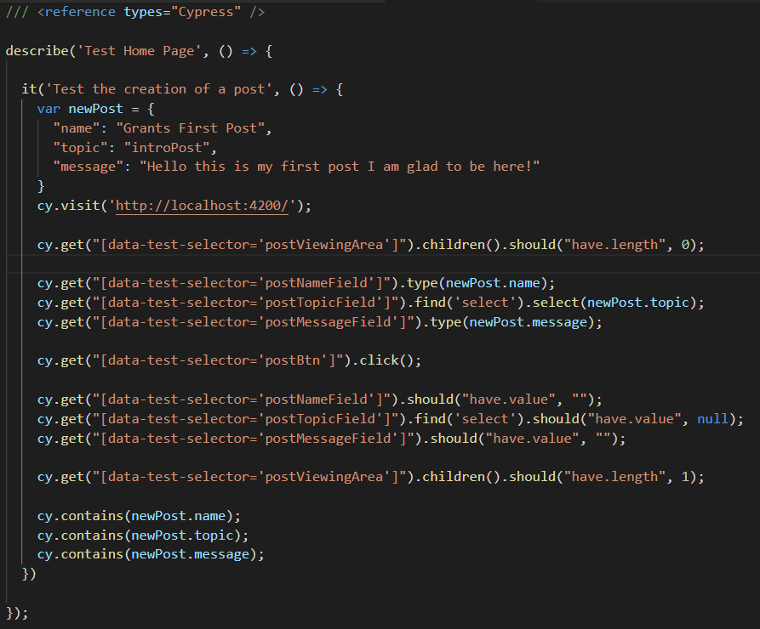
Write Our Test

Slide 8
Watch it fail!

Slide 9
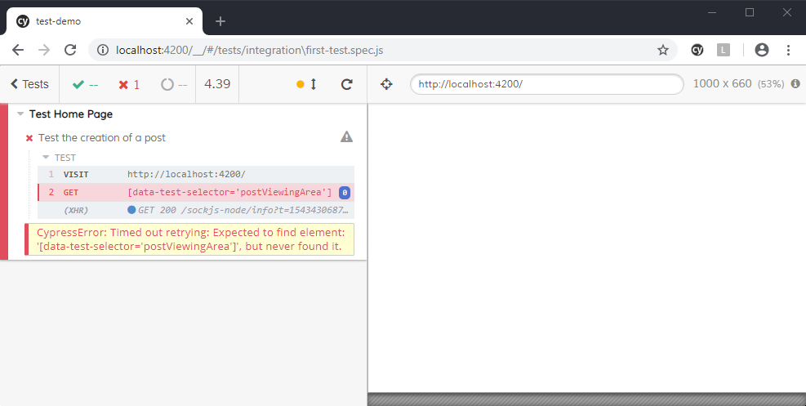

Slide 10
Write only enough code to fix the current error or failure

Slide 11


Slide 12
Rerun the test

Slide 13
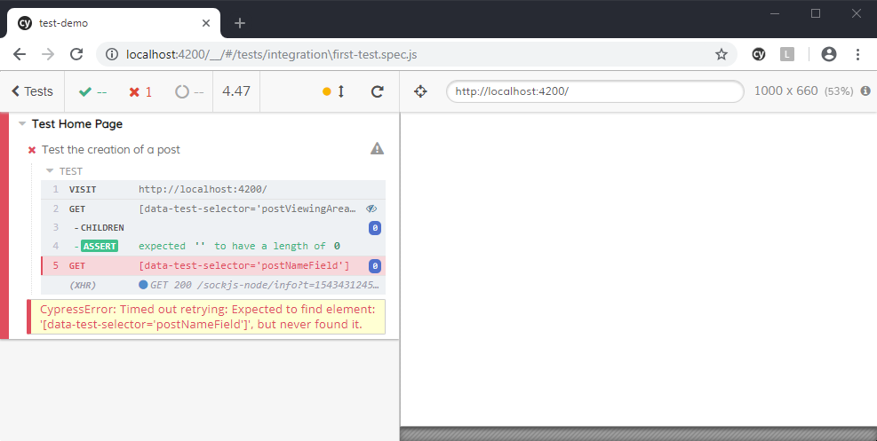

Slide 14
Fix the next error
Write the Code You Wish You Had

Slide 15
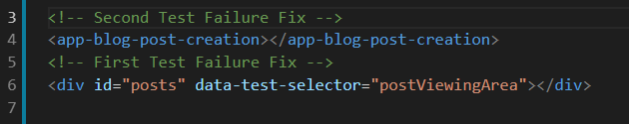
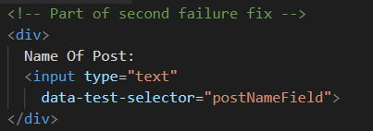
App.component.html
Blog-post-creation.component.html

Slide 16
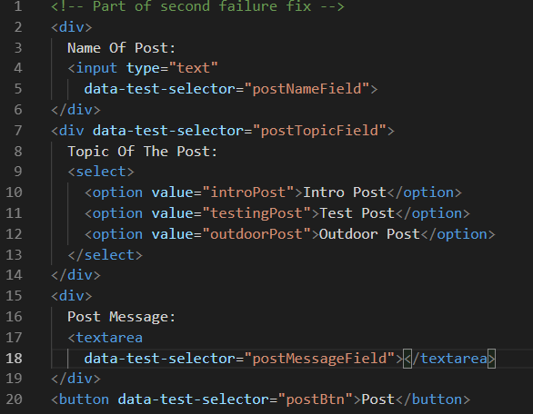
Next Failures
Notes:
Because all the next failures are similar to the last I will skip the part where we iterate step by step. And more to the next failure

Slide 17
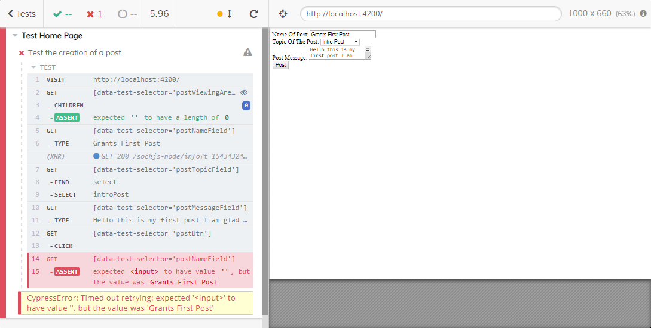
Next Interesting Failure

Slide 18
When we run into functional errors, start writing component tests to fix them

Slide 19
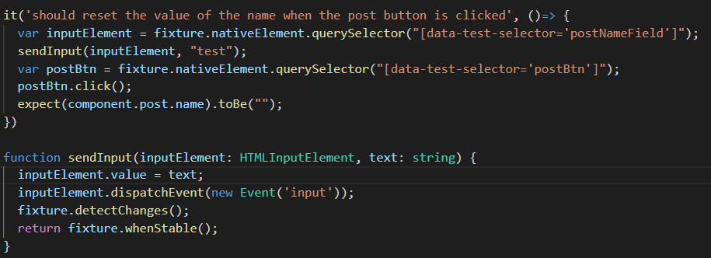
Notes:
There is a bit of other code in the .spec file that I did not include because its mostly just Angular specific.

Slide 20
Write the code to make it pass

Slide 21
